Slide 1
Smart Gym Management System
MySQL workbench + JSON Database Project
Submitted By : Pearl Sethi
Submitted to : Ashish sir

Slide 2
Project Overview
This is a Smart Gym Database System.
It helps in managing members, trainers, subscriptions, payments, and attendance.
I have used relational tables along with JSON data to make the system flexible and scalable.

Slide 3
Problem statement and solution
Problem statement
Solution
many gyms, data is handled manually or using registers. Because of this, there is poor tracking of members, payments, and attendance.
There is also no centralized system to analyze member performance or trainer details.
I designed a centralized database system using SQL and JSON.
The system is scalable, automated, and analytics-ready.

Slide 4
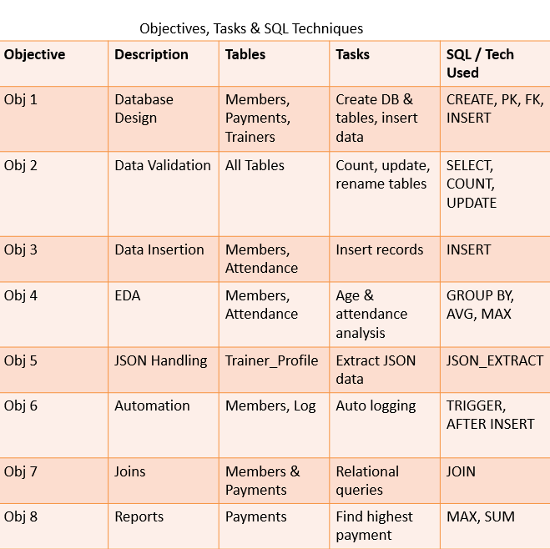

Slide 5
Objective 1: DATABASE
Tasks:
Create database
Create tables
Define data types
Apply constraints
Insert values : More than 60+ data insertion done
Structure of tables
Data

Slide 6

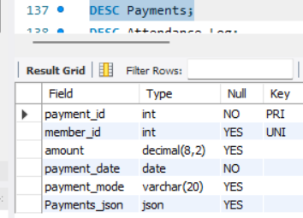
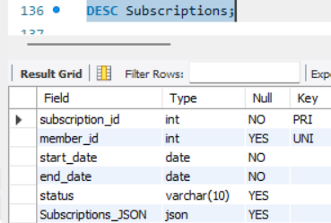
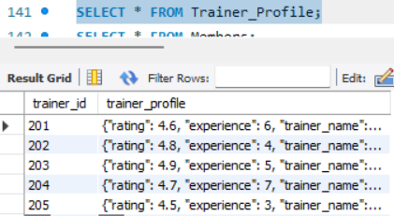
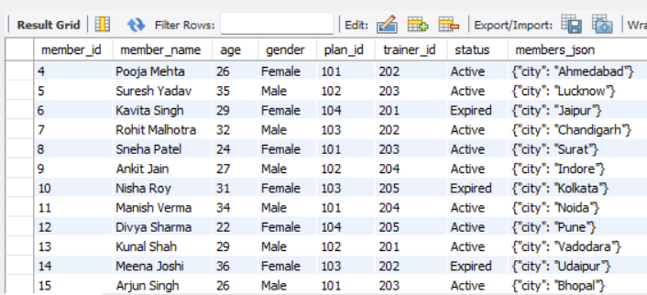
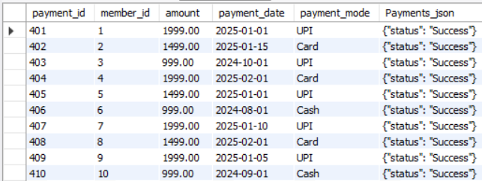
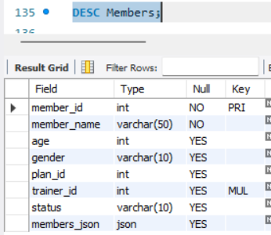
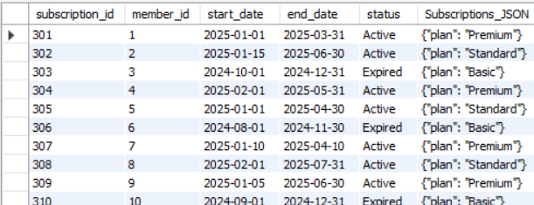
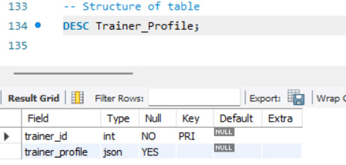
Tables we see our store data

Slide 7
OBJECTIVE 2 : Data Validation
Members (Central Table)
Trainer_Profile
Subscriptions
Payments
Member_Progress
Attendance_Log
Code to see tables

Slide 8
Objective 3: Data insertion
Tasks:
Table wise count
Add phone number in Members
RENAME TABLE
Update 1st first member as Expired

Slide 9
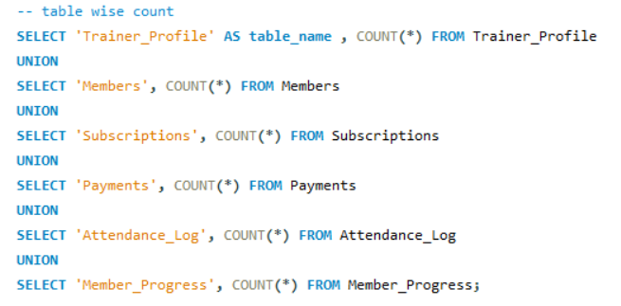
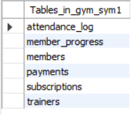
TABLE WISE COUNT
Code

Slide 10

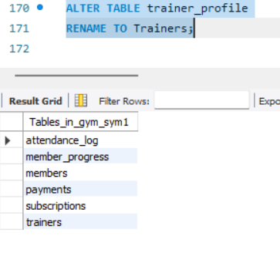
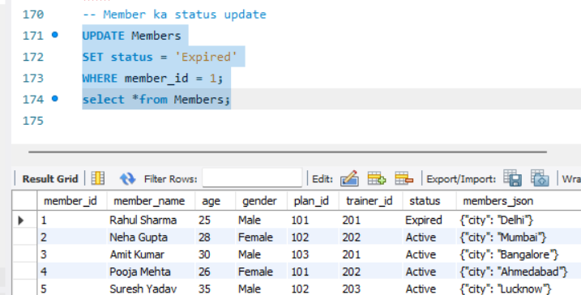

Slide 11
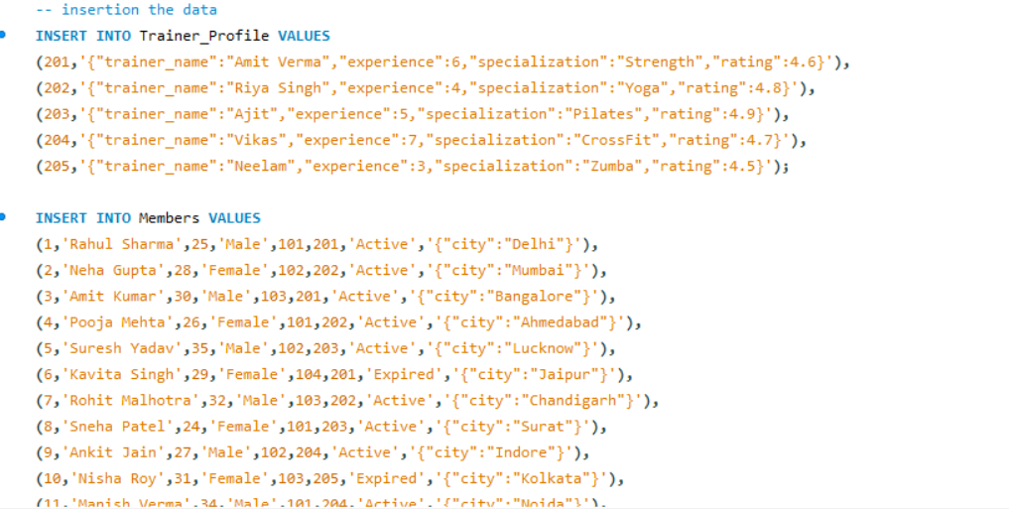
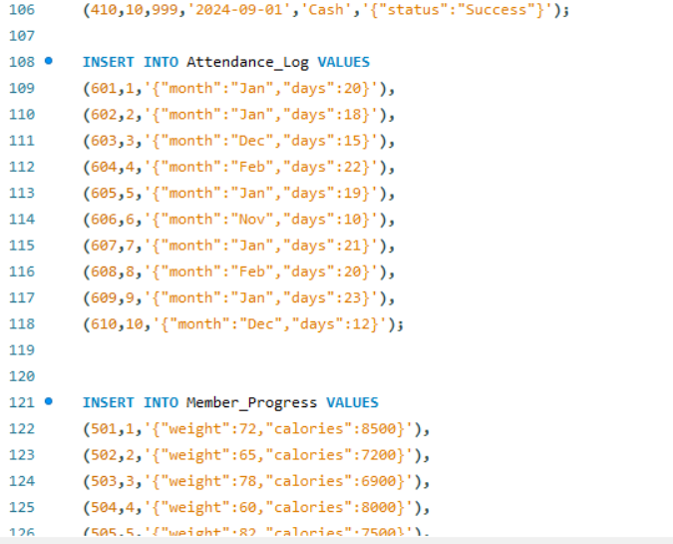
Objective 3: Data Insertion
Tasks:
Insert trainer data
Insert members and Attendance_log
Insert payments & subscriptions

Slide 12
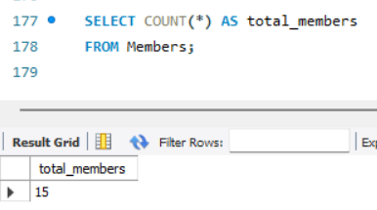
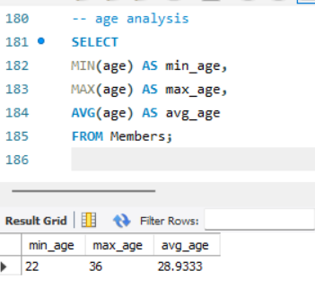
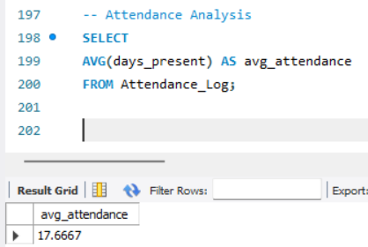
Objective 4: EDA
Tasks:
Count members
Age analysis
Attendance analysis
Count members
Attendance analysis
Age analysis

Slide 13
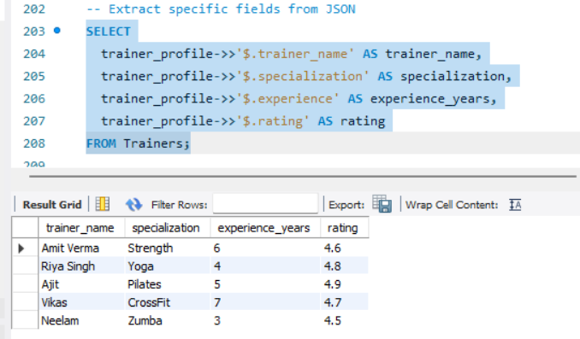
Objective 5
Extract specific fields from JSON

Slide 14
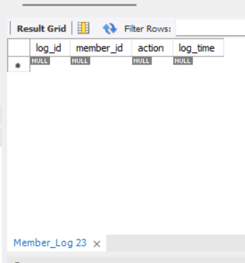
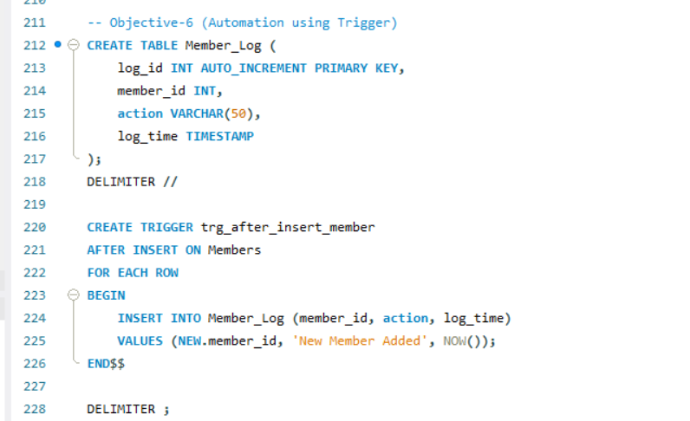
Objective-6 Automation
Created a trigger to automatically log member insertion events, reducing manual work.
Step 1: Create a Log Table
Step 2: Create Trigger
Step 3: Insert a Member
Step 4: Verify Automation

Slide 15
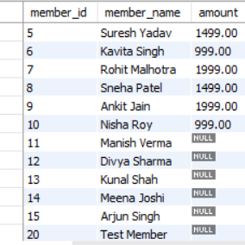
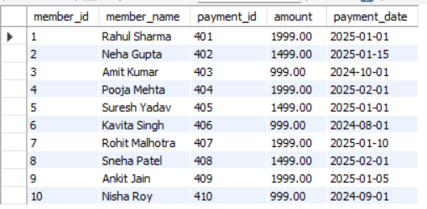
Objective 7 : joins
Members and payment
Members who paid and unpaid
Members with Their Payments

Slide 16


Objective 8 : Reports
Find sum of payments
Find highest payment

Slide 17
Tools Used
JSON
MySQL Workbench

Slide 18
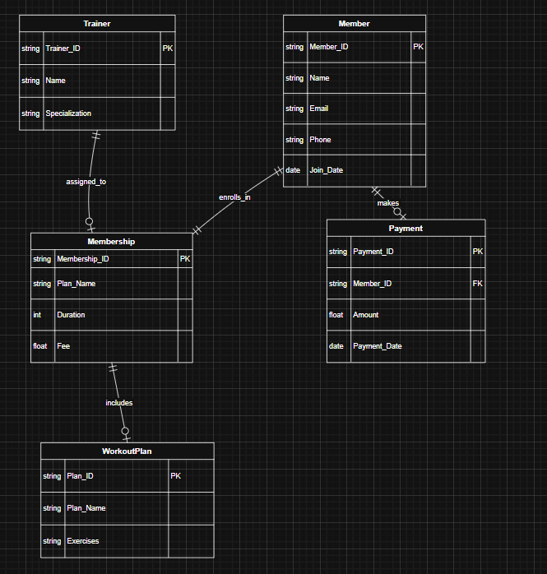
ER Structure

Slide 19
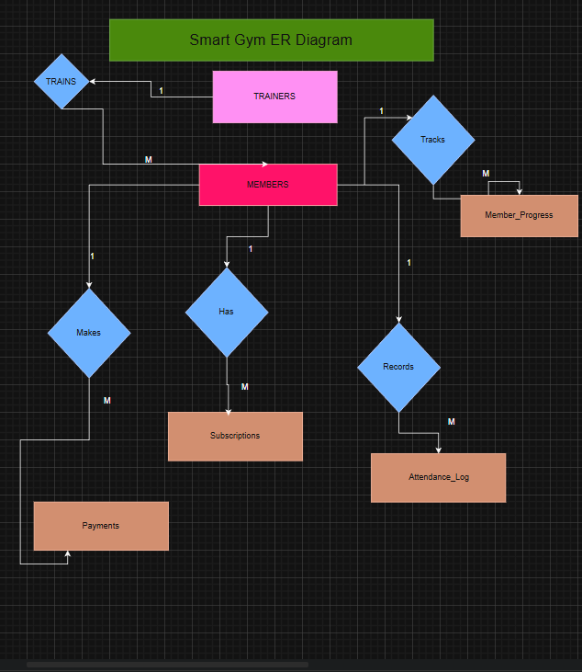
ER
DIAGRAM

Slide 20
Conclusion
This project demonstrates real-world database management using MySQL. It integrates relational and JSON data, performs analytical queries, and automates tasks using triggers. The system improves efficiency, accuracy, and scalability for gym management.

Slide 21
Real world use of this project
Gym member & payment management
Revenue tracking & reports
Automation using triggers
Scalable and analytics-ready system

